Slide 1


American Cancer Society
Allison Norman
History
Purpose
Testimonials
Conclusion

Slide 2
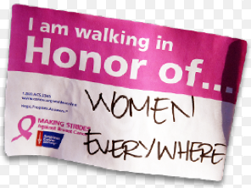


History of the American Cancer Society
The American Cancer Society was founded in 1913 by 15 prominent healthcare physicians and business leaders in New York City.

Slide 3

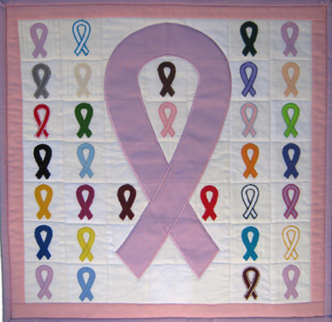

Where It’s Located
The American Cancer Society is based out of Atlanta, Georgia, and has more than 900 local offices across the United States.

Slide 4



Significant Accomplishments
About $148.5 million was put in to research. This help finance 240 new research grants and 60 health professional training grants all across the Nation.

Slide 5



Mission Statement
“For 100 years, the American Cancer Society (ACS) has worked relentlessly to save lives and create a world with less cancer and more birthdays. Together with millions of our supporters worldwide, we’re helping people stay well, helping people get well, finding cures, and fighting back against cancer.”
-American Cancer Society Representative

Slide 6

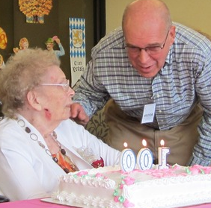

The Goal of the Organization
The goal of the American Cancer Society is to have more birthdays and less cancer.

Slide 7
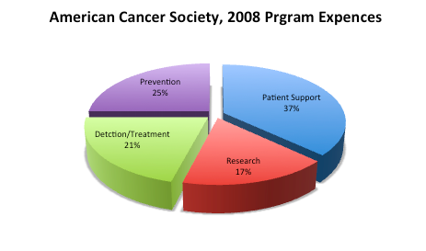


Money and Spending
Over the duration of the year 2011, the American Cancer Society raised and contributed $947 million to the cause of reducing the risk of cancer.

Slide 8



Testimonials
"They would tell my Mom I had only had 5 months to live, then they would say 2 months to live, but every time I surpassed it; I beat it." Aaron Knight is meek and humble as he speaks of his childhood battle with cancer. Aaron is now a 21-year-old, and a college junior. He recalls playing with other kids, but instead of running around on the playground, his playmates shares a spot in the oncology ward.

Slide 9



Aaron’s Story
When Aaron was born, there seemed to be a variety of complications as he spent the first few months of his life in intensive care. By the time he was five months old, the doctor had informed his parents the he had leukemia.

Slide 10
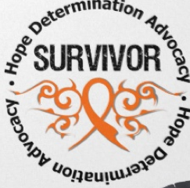
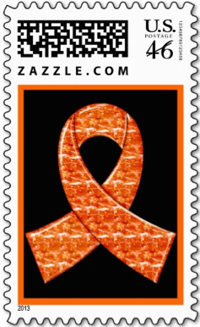

Aaron’s Story
By the time Aaron was three he was out of the hospital and out playing with other kids his age. This was a time when he was still in treatment, but they were working on getting his cancer in remission. By the time he was four, he and his family were informed that he was finally in remission against all of the odds. Aaron will never forget how much the American Cancer Society helped him in his life.

Slide 11


Conclusion
The American Cancer Society has help hundreds of thousands of people through its duration. It has helped small communities and big cities and no one is ever turned away. The American Cancer Society cares, and that is why we should choose this charity for this years NPBay donation recipient.

