Slide 1
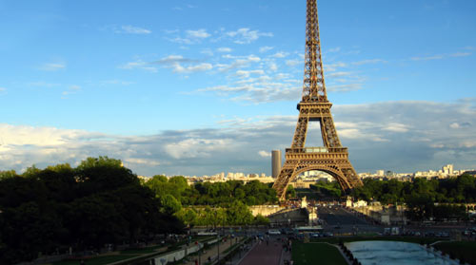
It’s a Small World: France
By: Allison Norman

Slide 2
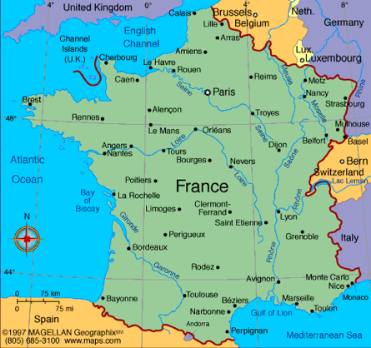

Country Information
Population: 67 million
Economic Resources: agriculture and livestock
Main Exports: wheat, potatoes, corn, sugar beets, and barley
One of the top producers on wine in the world
Center of wine trade: Reims, Cognac, Épernay, Bordeaux, and Dijon

Slide 3
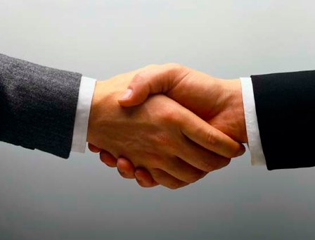
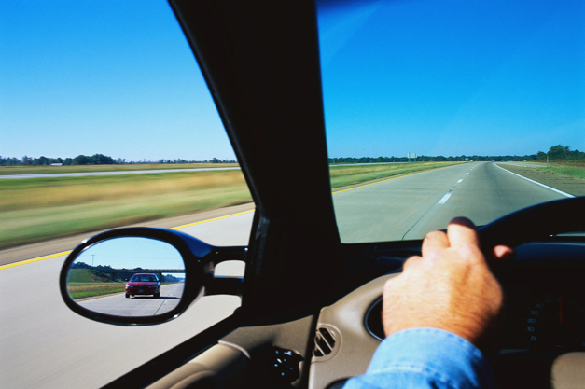
Things you should know
Drive on the right side of the road
Greet with a hand shake or bisous
Keep your voice down
People do not smile at each other

Slide 4
Common Words and Phrases
Aide-mémoire- meaning “memory aid” in English, is a term used to represent the taking of notes or use of short hand
À propos- meaning “to the purpose of” in English, is a term used to show that a person is trying to go straight to the point
Chargé d'affaires- meaning “charged with business” in English, signifies a change in management of a job

Slide 5
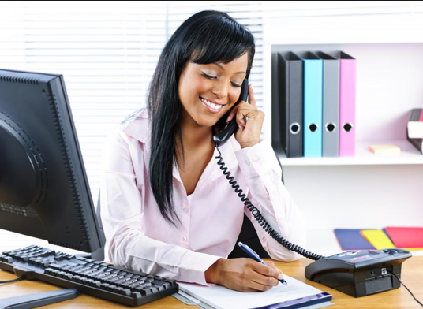
Appointments
To make an appointment you should call the office and be connected with the person you wish to the secretary of the person you want to make an appointment with

Slide 6
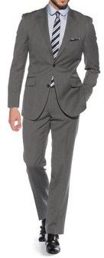
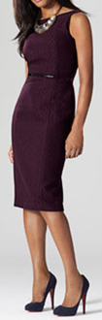
Business Attire
Men
Women
Dark suit
No blue shirts
Keep jacket on at all times
French cut suit if possible
Simply, but elegant
Business suit or dress
Conservative make-up
Light accessorizing

Slide 7
Topics of Conversation
Appropriate Topics
Topics to Avoid
French History
Art and Food
Philosophy
Sports: Tour de France, tennis, and soccer
Politics
Personal questions
Criticism of Napoleon
Do not start a conversation asking a person what they do

Slide 8

Respecting Others
It is never okay to “drop in” on someone, no matter the occasion it is considered rude
Punctuality is taken lightly in France, especially in Southern Prance
Ten minutes after a scheduled time is not considered late
When invited to someone’s home, it is customary to bring a gift

Slide 9
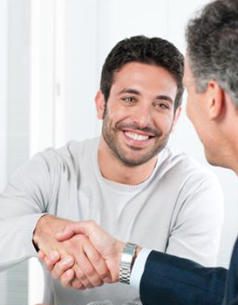
Negotiating
Stay focused on what needs to be accomplished, don’t venture in to other subjects
Do not talk about personal matters
When the person you are negotiating with restates their initial view on the topic, that it a sign that the negotiation is over

Slide 10
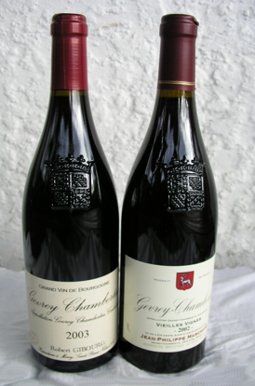
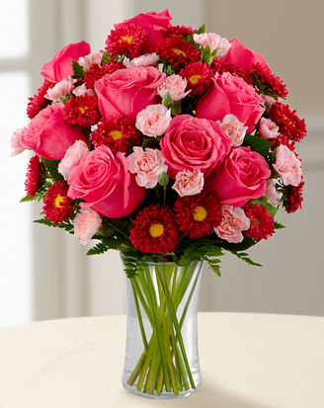
Entertaining
When hosting a dinner party, the meal usually starts around 8 p.m.
Be prepared for the meal to last for around three hours
If your guest brings flowers, put them in a vase and sit them on the dinner table, if they bring wine, drink it with dinner

Slide 11
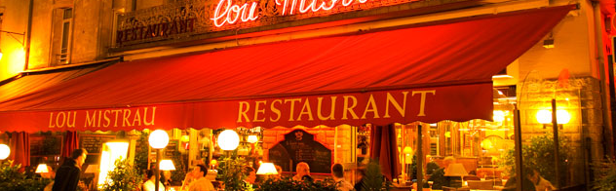
Dining
Breakfast- most restaurants are not open for breakfast other than fast food and coffee shops
Lunch- Restaurants that serve lunch usually open at 11:00 and will continue to serve in coming customers until 1:00
Dinner- most people eat dinner from 7:30-8:30. Most restaurants do not open dinner until 8:00

Slide 12
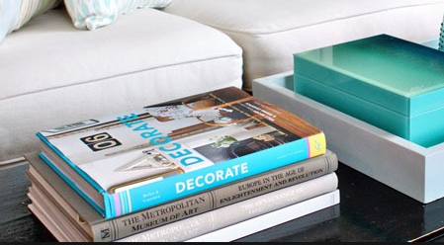
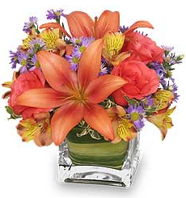
Gift Giving
If you are invited to someone’s home bring flowers or liqueur for the host
Do not give gifts with your company logo on them
Do not include your business card with your gift
Do not send gifts to business associates homes
A good gift for a business associate is a coffee table book about your home country

Slide 13
Compare and Contrast
Things that are the same
Things that are different
We drive on the right side of the road
In some situations it is considered okay to “drop in” on people
We make appointments in a similar fashion here
The suits that men wear are cut differently here
We tend to eat dinner earlier here
We consider being prompt important

Slide 14
Sources Cited
http://about-france.com/food-and-eating.htm
www.americancommunityinfrance.com/dos-donts-hosting-a-dinner-party-in-france/
http://www.executiveplanet.com/index.php?title=France:_Conversation
http://businessculture.org/western-europe/business-culture-in-france/business-etiquette-in-france/

